Slide 1

(CS4042D) Assigned by - Mrs. Lashma K Created by - Sourav Das (M200722CA) - Geetanjali Bankira(M200692CA) - Mrityunjay Kumar(M200704CA)
WEB PROGRAMMING PROJECT

Slide 2

OVERVIEW OF PROJECT
This project is based on the marketing of books that will be bought and sold through this e-commerce site, this will provide different kinds of books that can be uploaded by anyone who wanted to sell their books at their own suitable price. Site is created by different types of programs which include JavaScript, PHP, HTML & CSS , Bootstrap, MySQL along with DBMS.
This is partially dynamic site which contains information which can be changed according to the user preferences and also contains lots of good features such as
-easy return policy
-cash on delivery is also available
-easy return and refund
The developer has the access to maintain and control the database which again has different section to control the data easily, if something is no correctly filled by the user the they can complin about it and developer can resolve the issue as soon it appears.

Slide 3

Project design
Data Base
Registration
My cart
view books
My order
Sell books
User id
contact
User name
password
email id
confirm password
User id
User id
user name
user name
image
image
price
price
user id
book name
author name
category
user id
language
purchase data
user name
book condition
image
price
price
description

Slide 4

INDEX PAGE
The main page of the site has 3 sections
(i)Navigation bar (helps to navigate through different web pages)
– consist of different buttons
home, login ,signup , gallery buttons etc.
(ii) contact section
-details are provided for the site
-helps to provide feedback
(iii) privacy policy along with important links
- social media
- site services

Slide 5


Slide 6
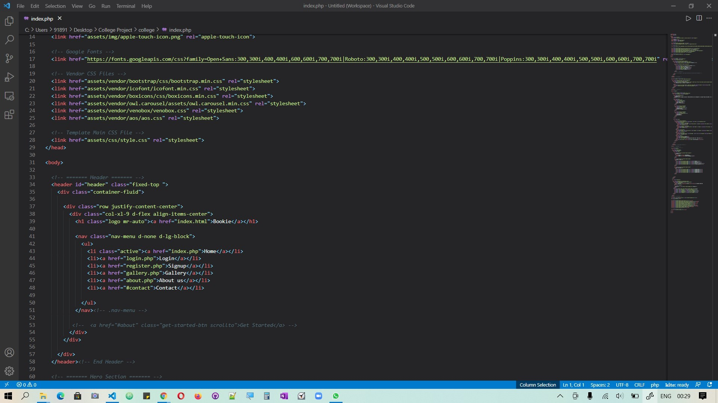

Slide 7
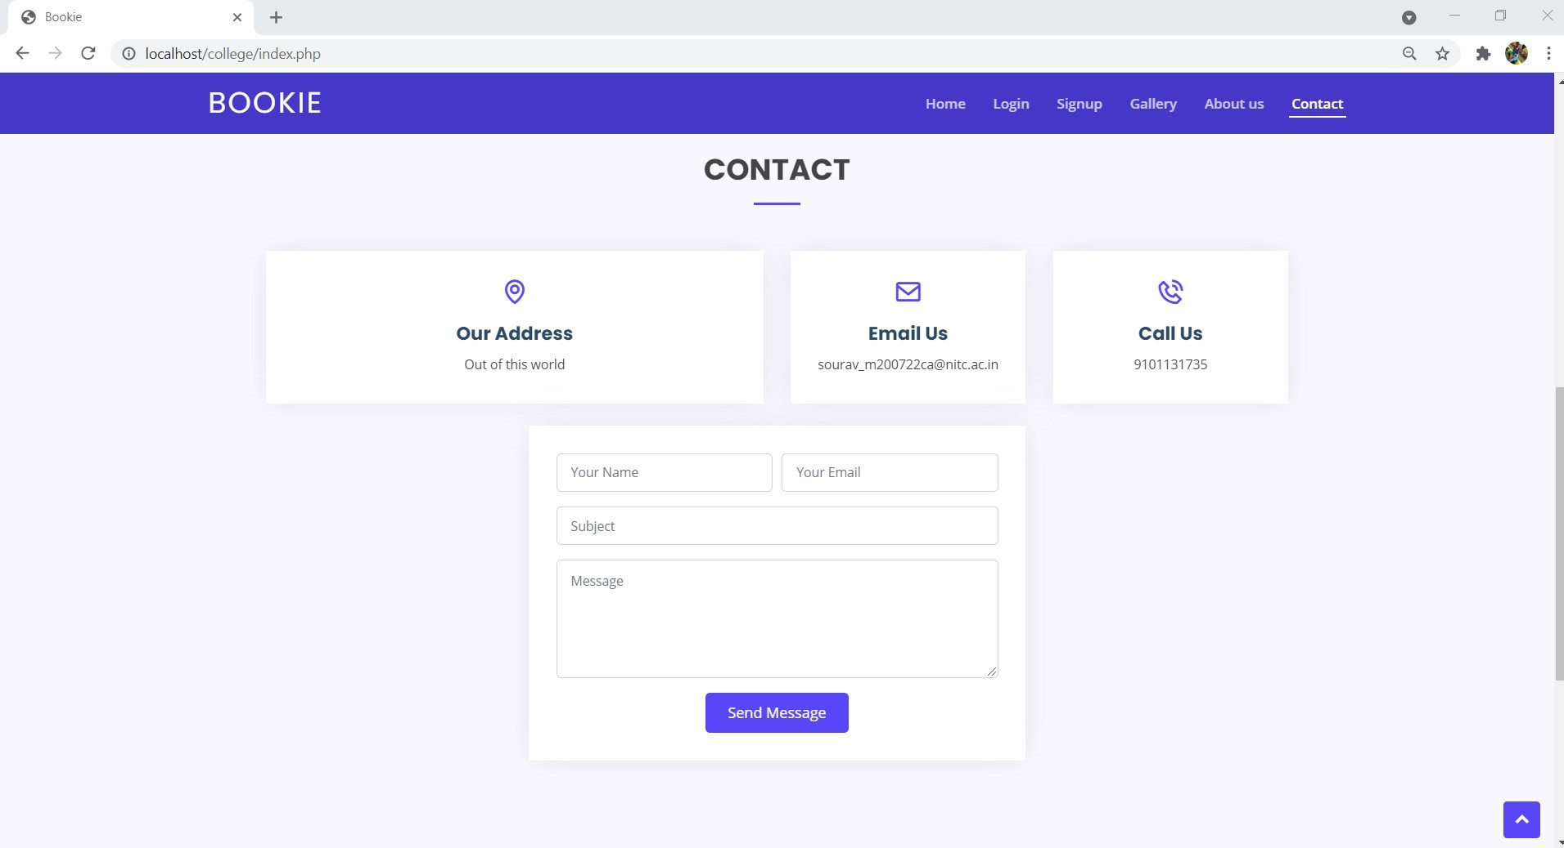

Slide 8
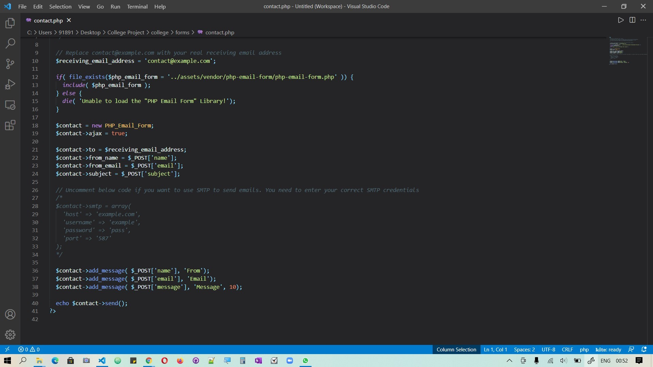

Slide 9
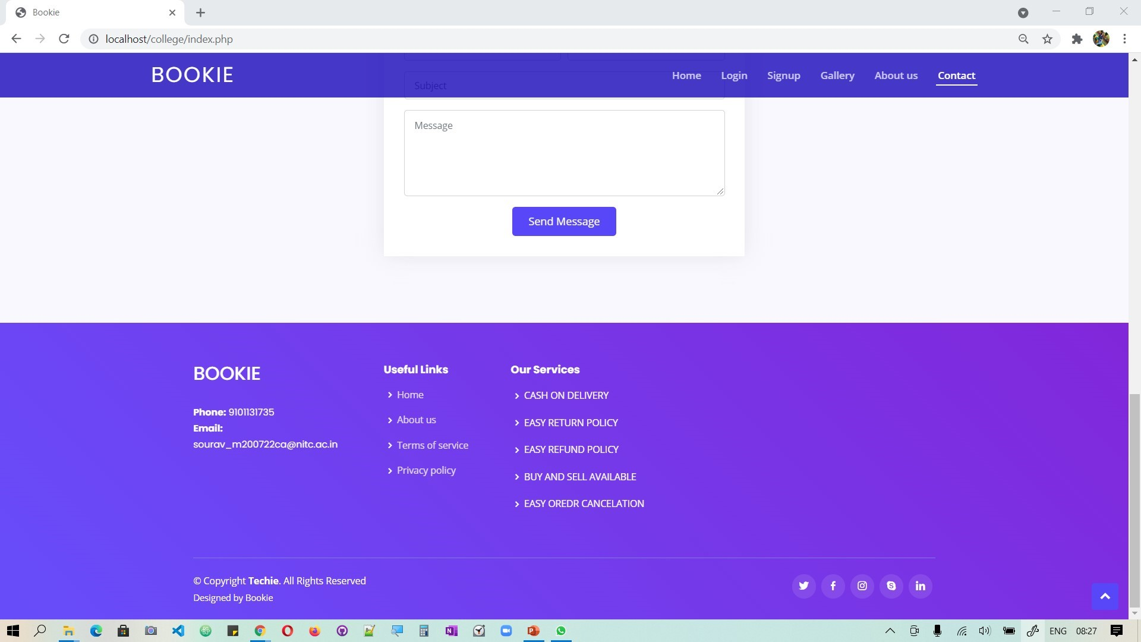

Slide 10
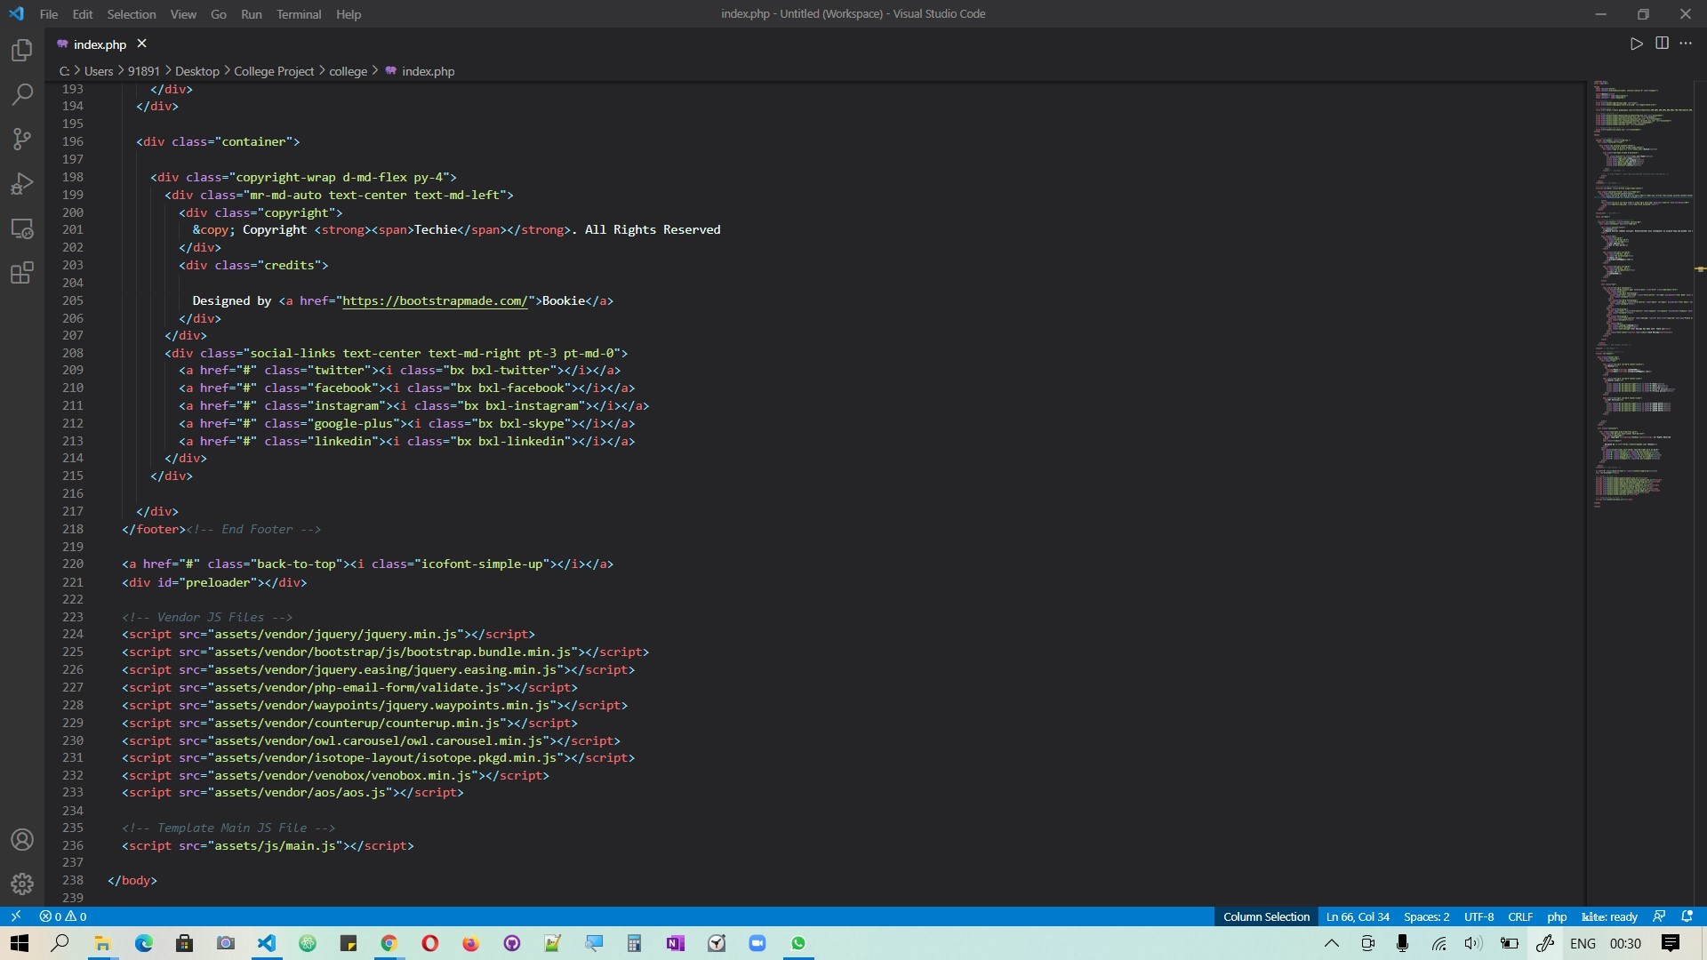

Slide 11

Accessing to site
User need to firstly sign up by filling some basic details which can be stored in database such as username, email id, mobile no and password.
After signing up we can directly login to the site using provided email id and password .
If in any case user forgets the password then he/she can recover it , by using registered email id and contact number after that the user will get his/her password that they used previously through an alert message box.
If every steps are done correctly and successful the site will be directed to the sell books page .

Slide 12
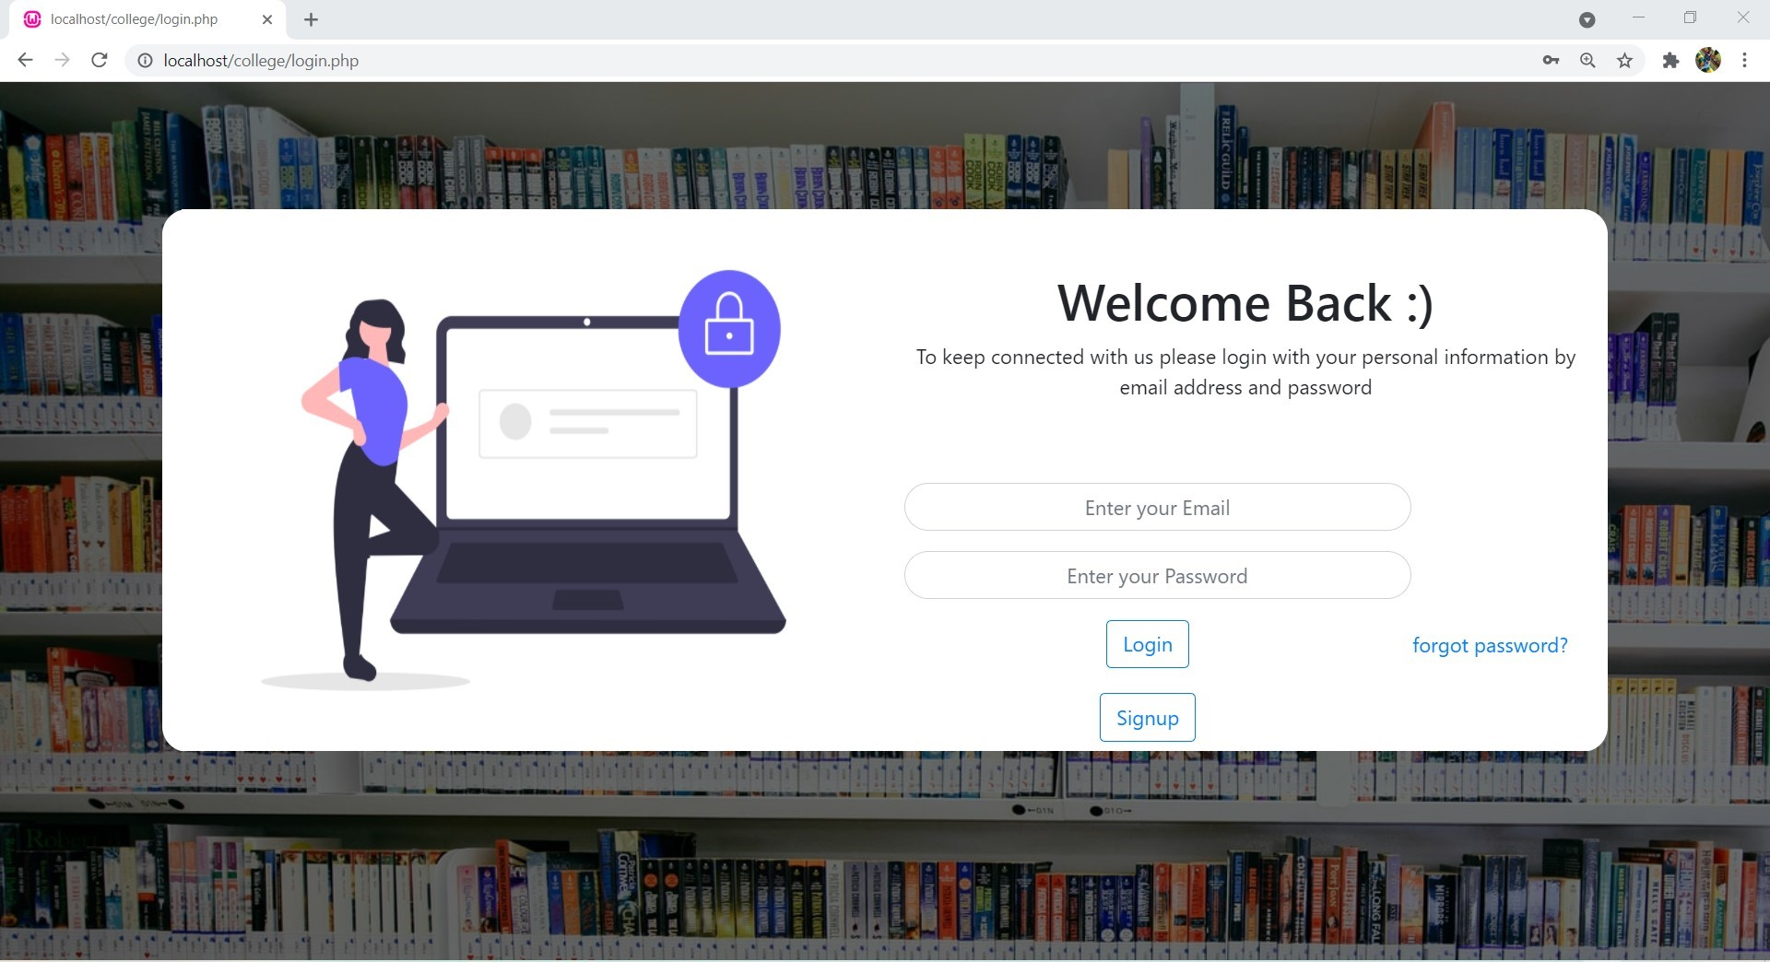

Slide 13
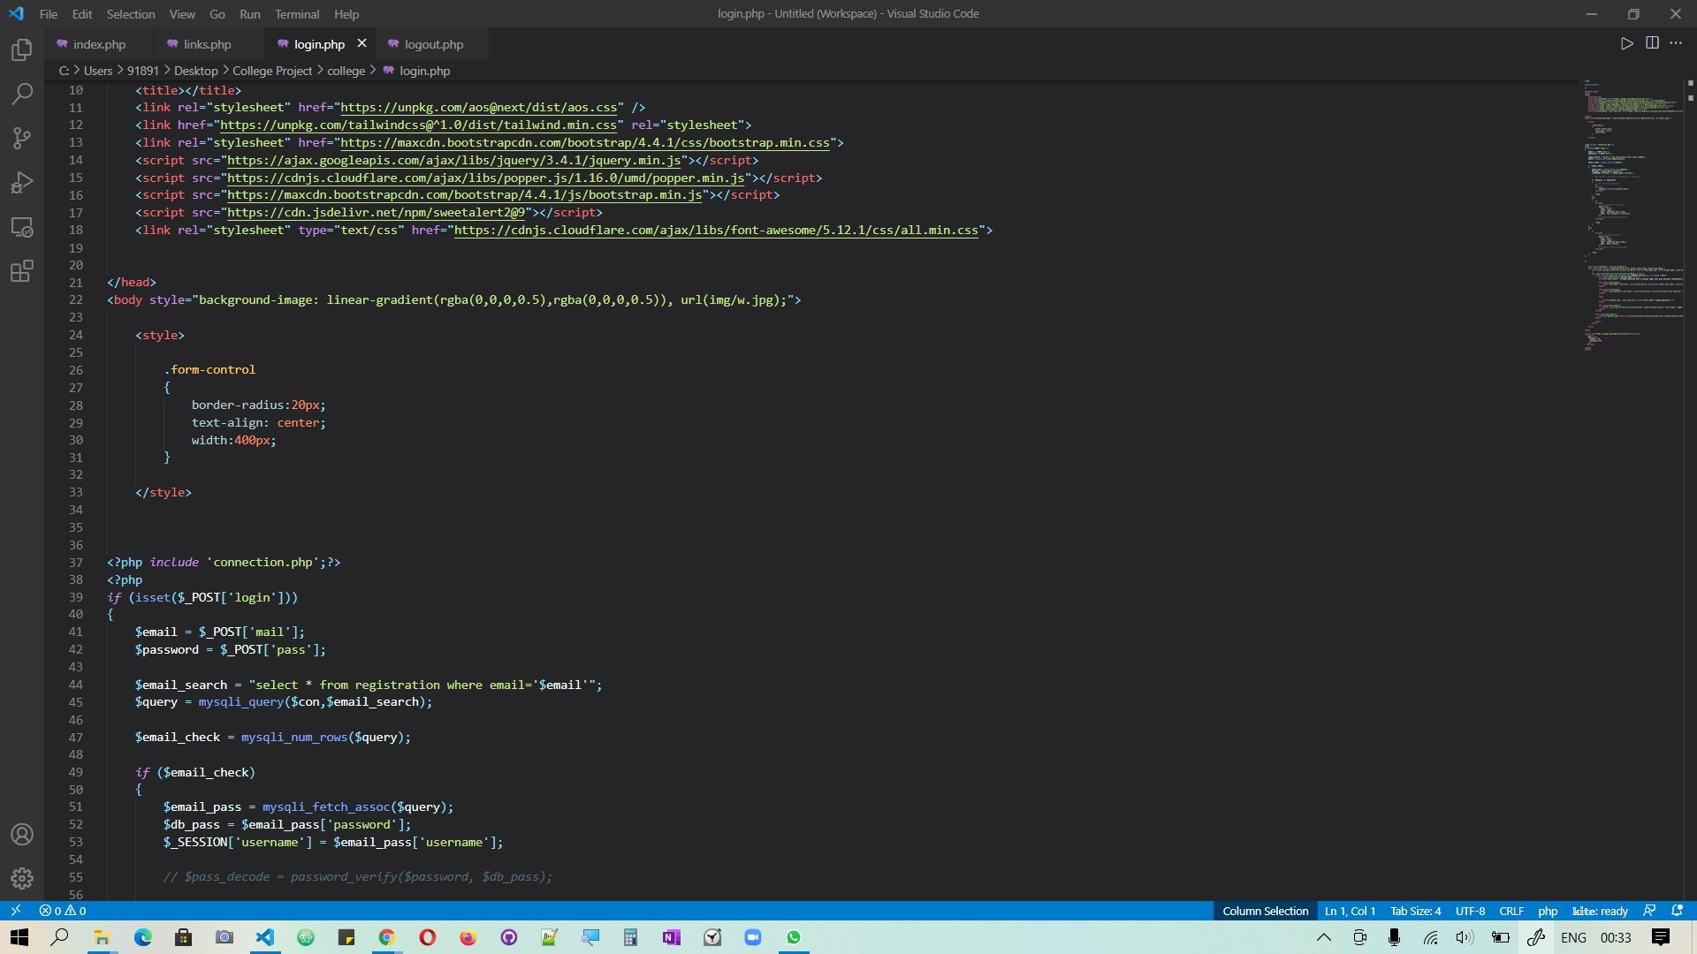

Slide 14
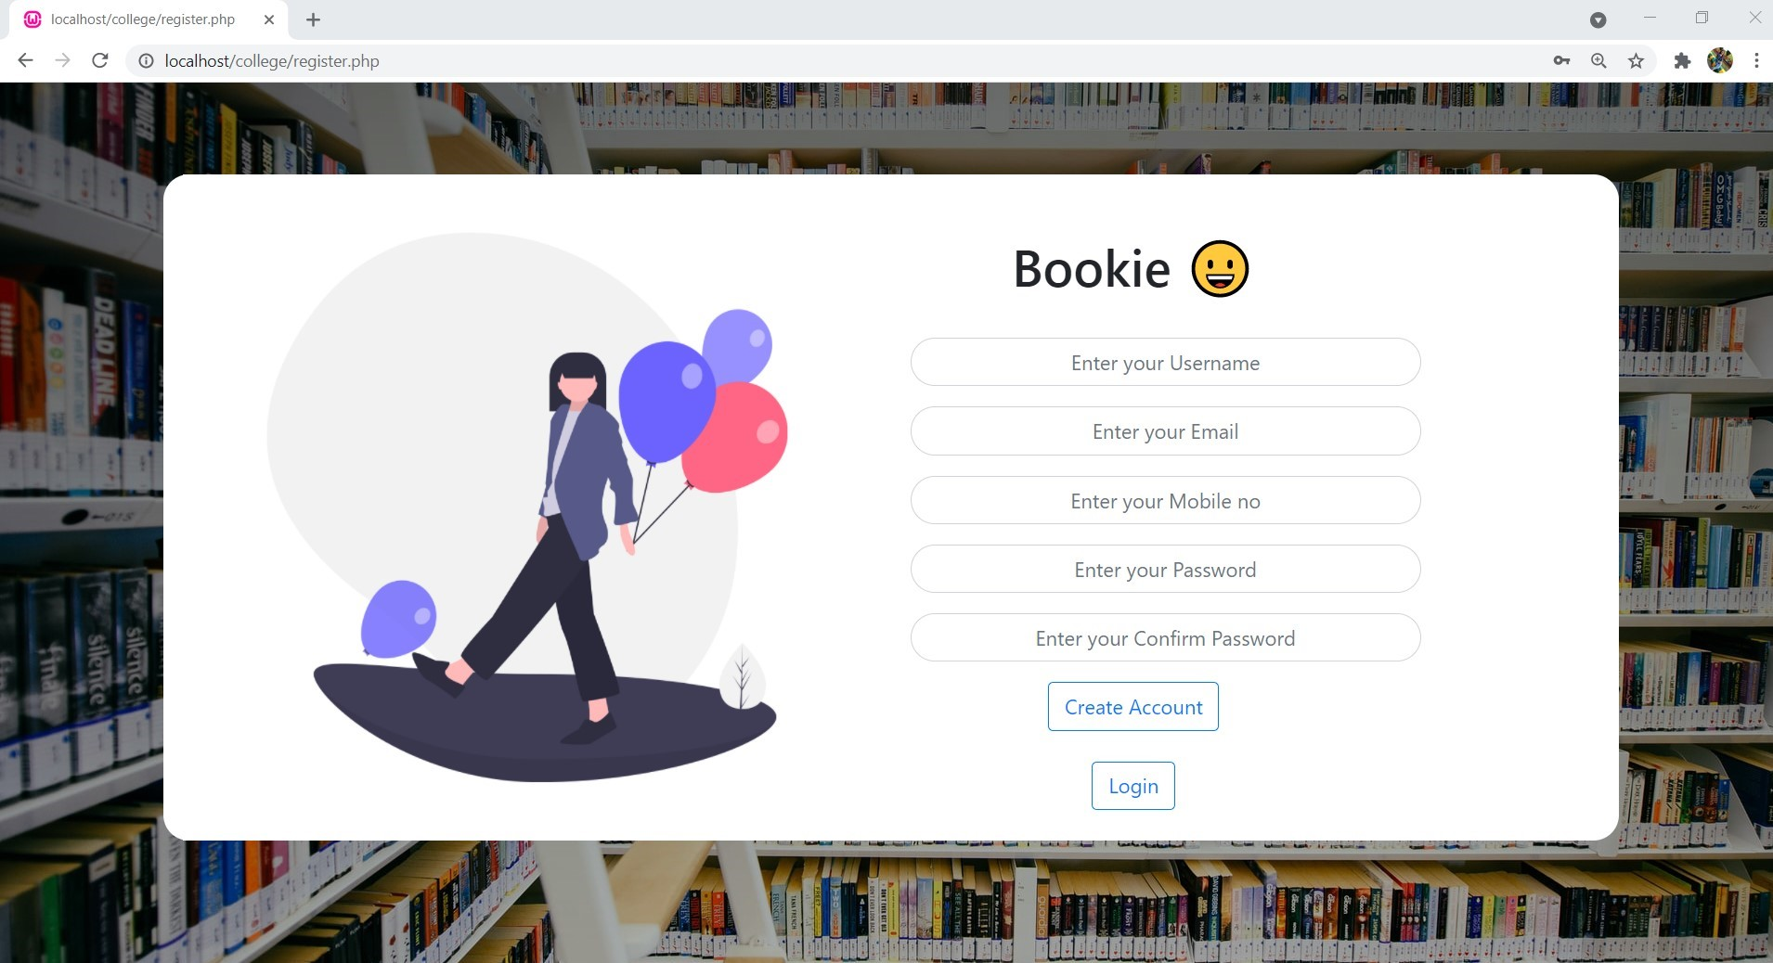

Slide 15
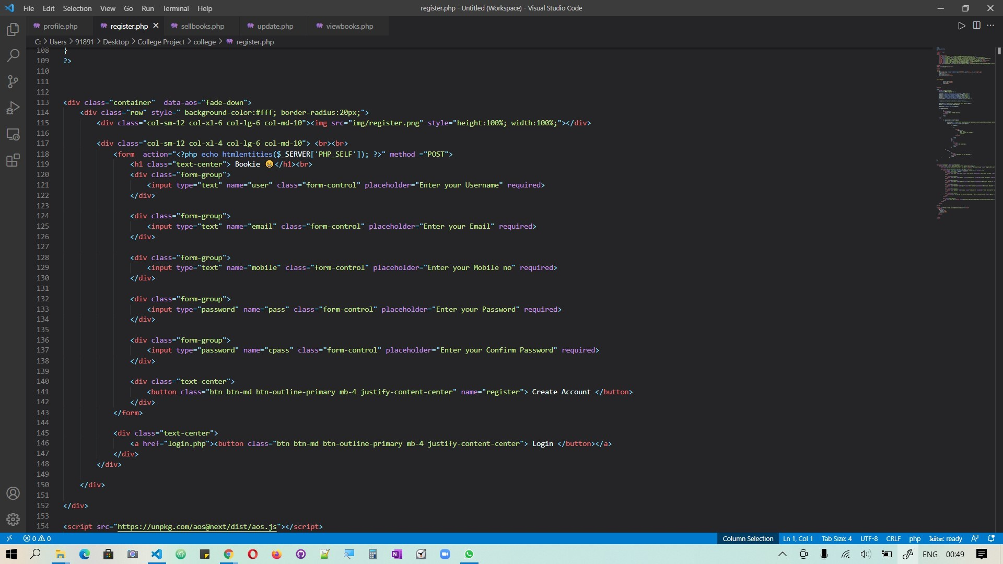

Slide 16
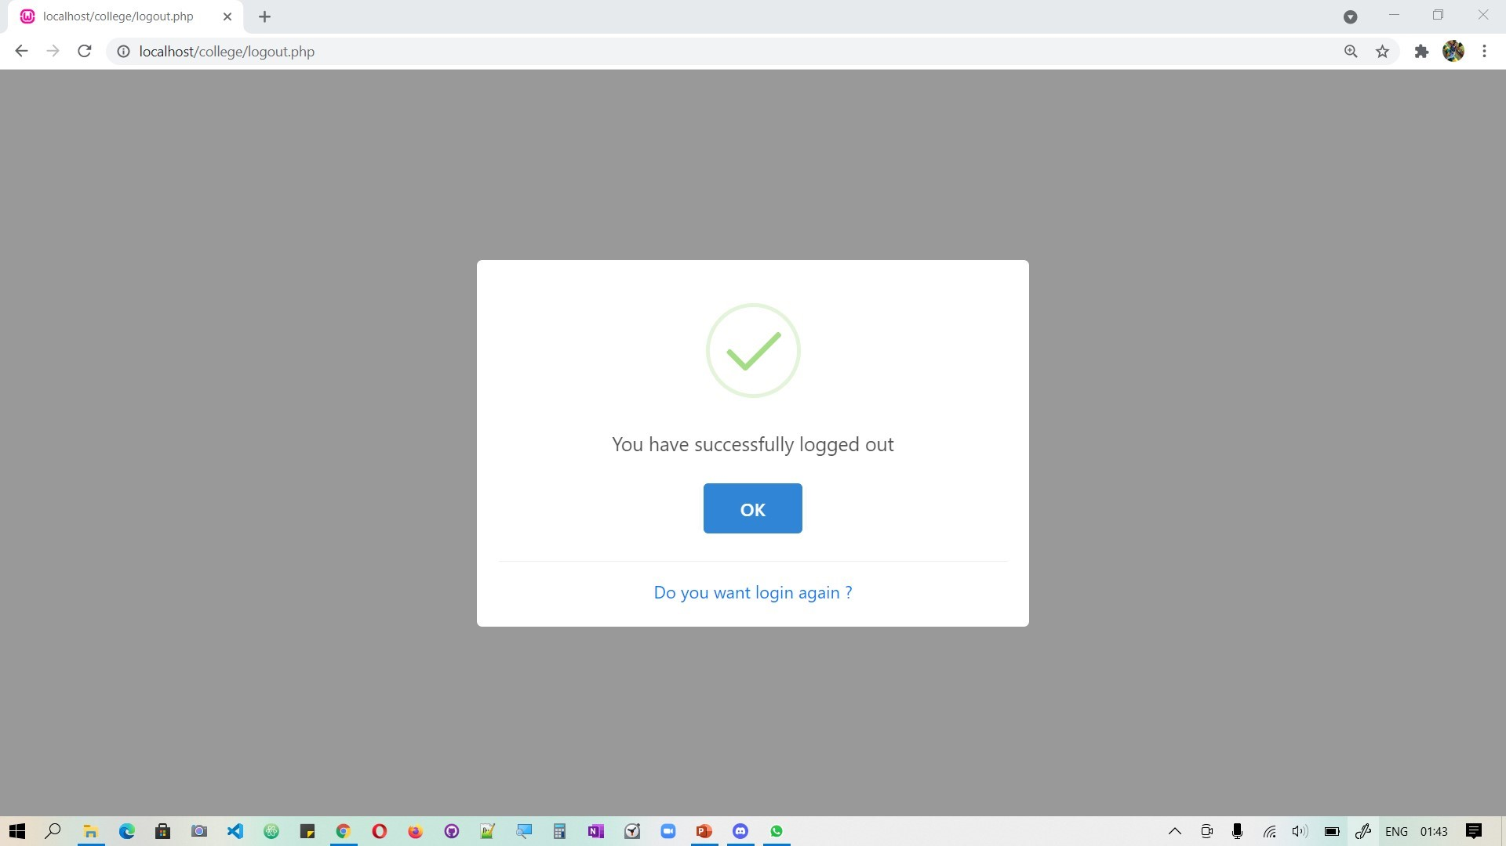

Slide 17
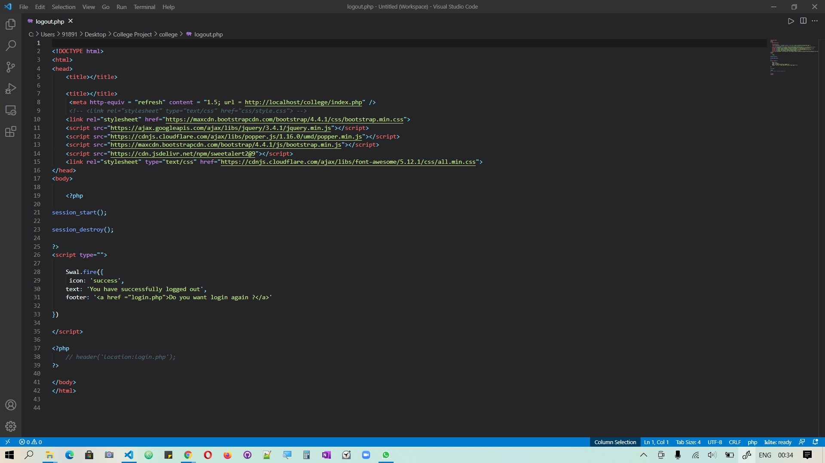

Slide 18
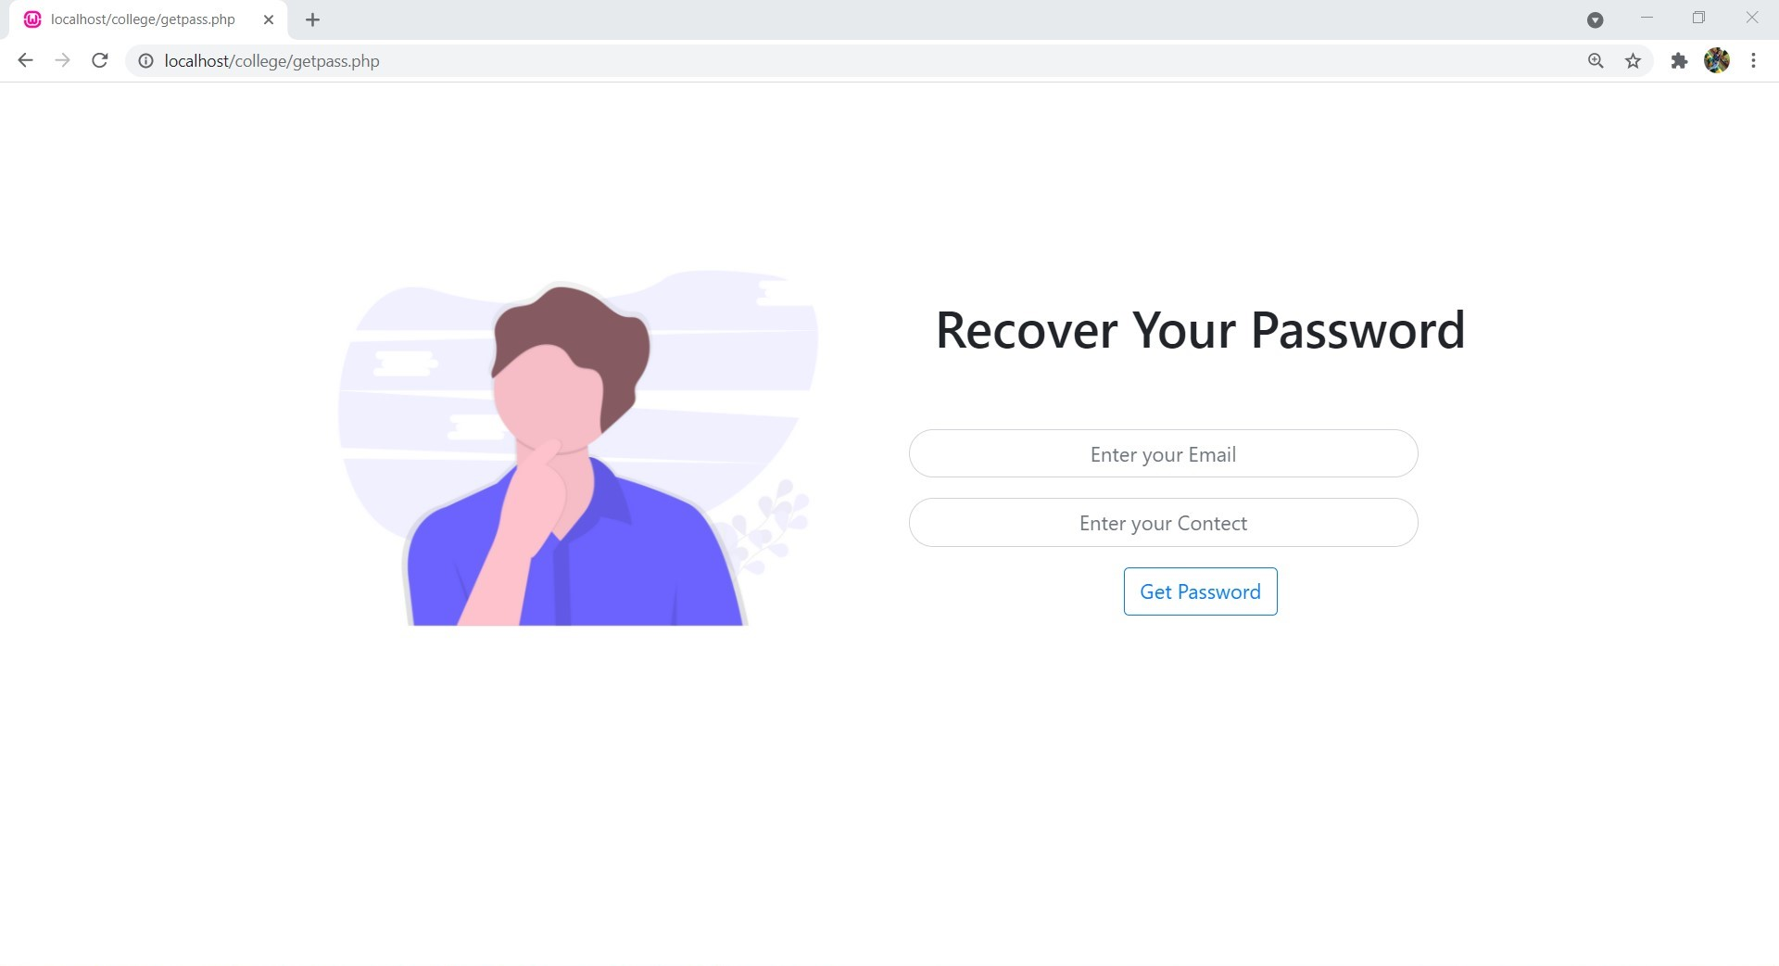

Slide 19

SELL BOOKS
This page consist of many text labels for book name, author name, category and language of book, purchase date ,condition of book price and description.
Category ,Book language , Book Condition has drop down boxes which has various options to select.
There is an action button which helps to upload the file .
One more section is available as text field for providing the description of the book that user wanted to upload for selling.
And lastly a button is available to add the book in database as well as it will be listed in viewbooks page.

Slide 20
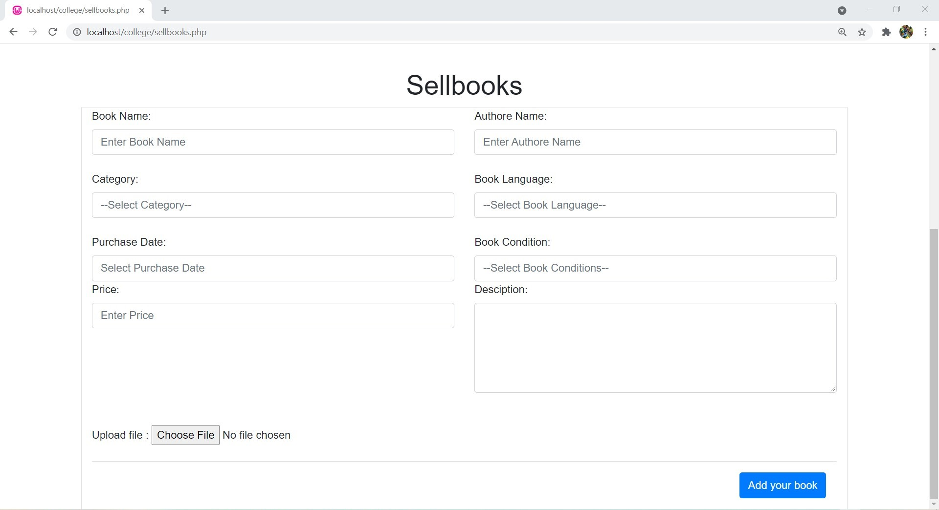

Slide 21

MENU BAR
This consist of profile , mybooks, sell books, view books, myorder ,my cart ,gallery ,logout , about us section.
This menu bar helps in accessing to different pages by clicking on to the option .
Profile section has different parts such as name, phone no ,email id, address of the user .
Myorder section has the function where the products will be moved from mycart.
About us is all about the developer team
Viewbooks has all the books that are available on this e-commerce site .
Viewbooks has plenty of books starting from course text, novels ,self help books .

Slide 22
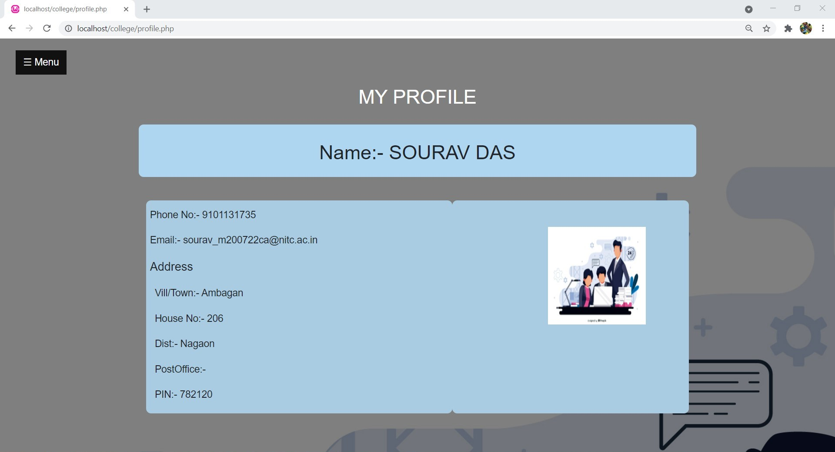

Slide 23
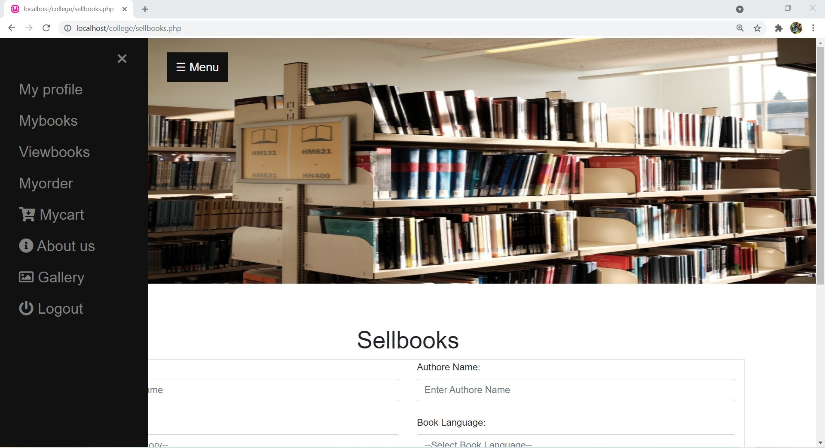

Slide 24
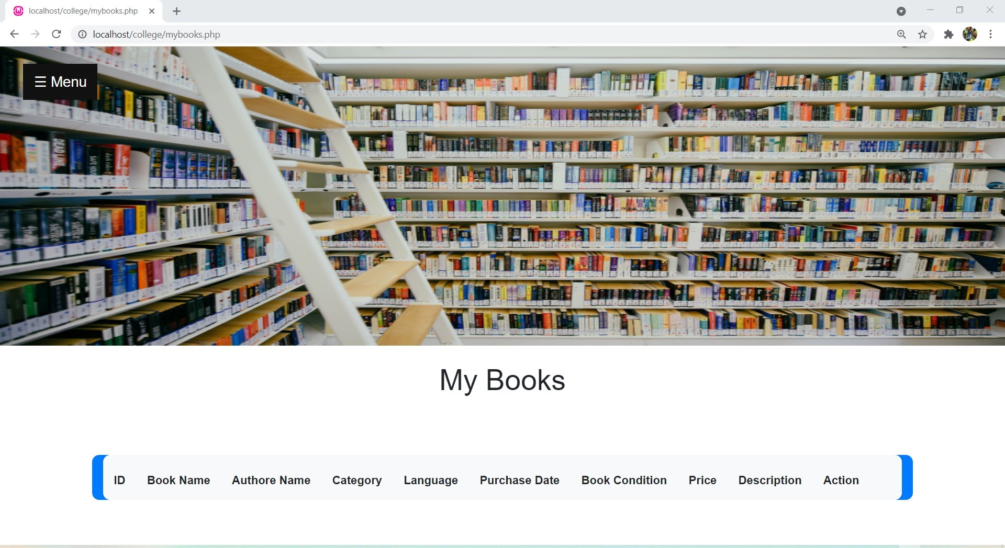

Slide 25
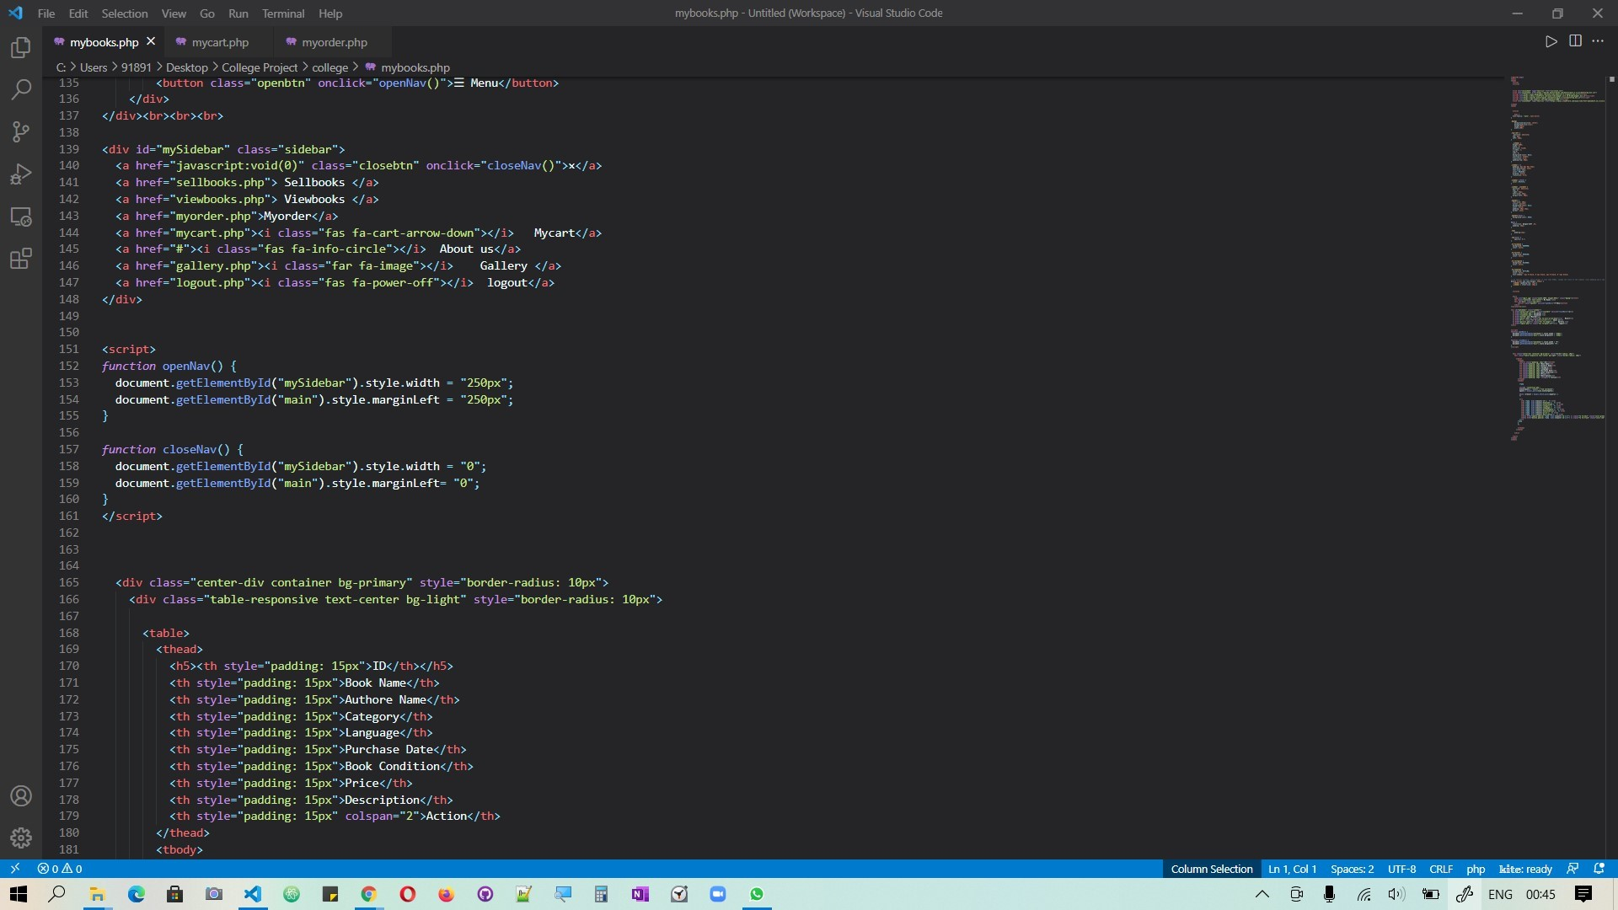

Slide 26


Slide 27
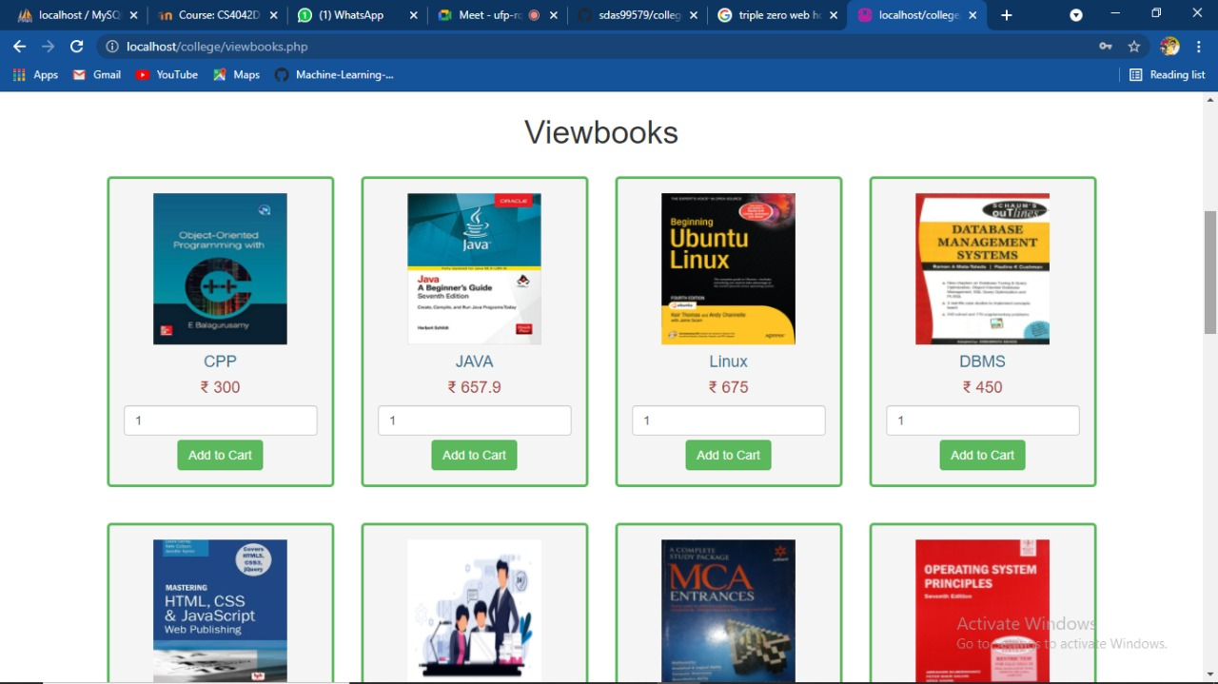

Slide 28
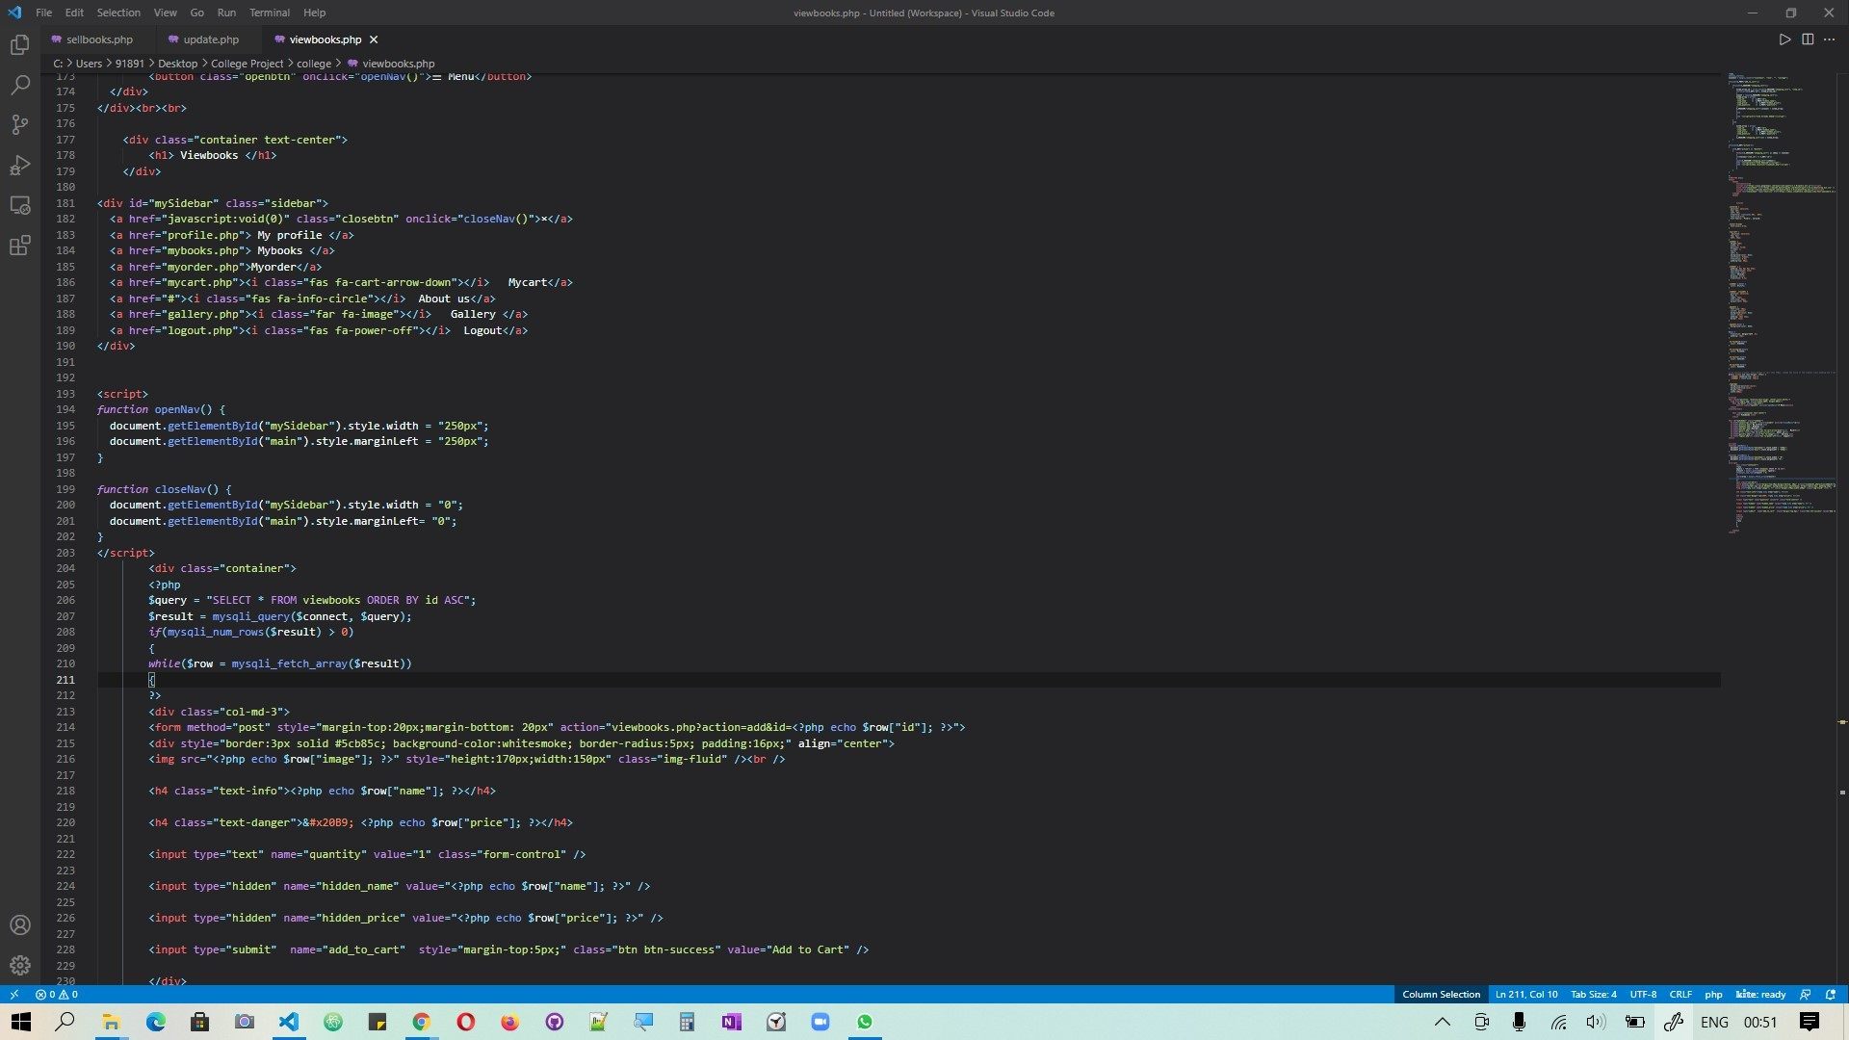

Slide 29

MY CART
This will have the pre order list to calculate the amount to be paid at the time of payment.
This is in the format of table having different columns such as Item name, quantity , price, total, action.
Quantity is the number of books of particular type.
Column of total will help to calculate the total amount for all the added products.
Action section has two function add or remove the book that user choose to order.

Slide 30
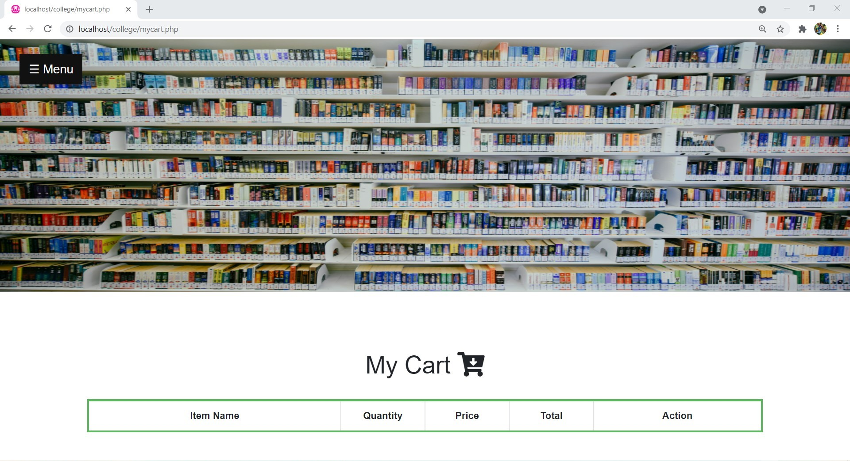

Slide 31
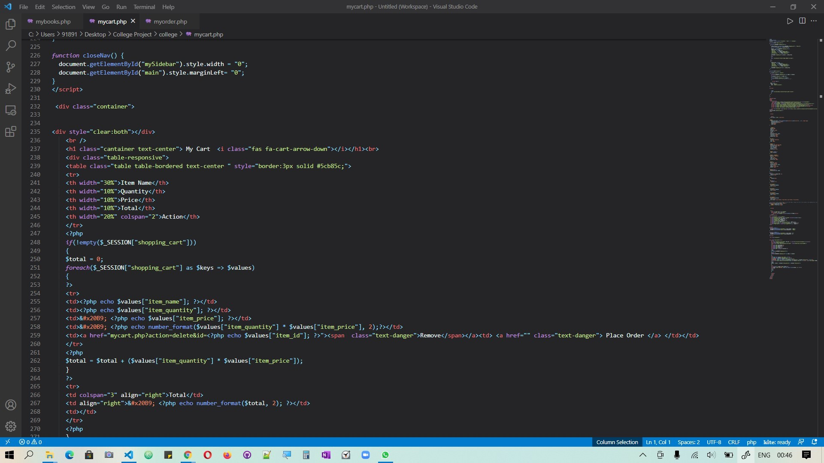

Slide 32
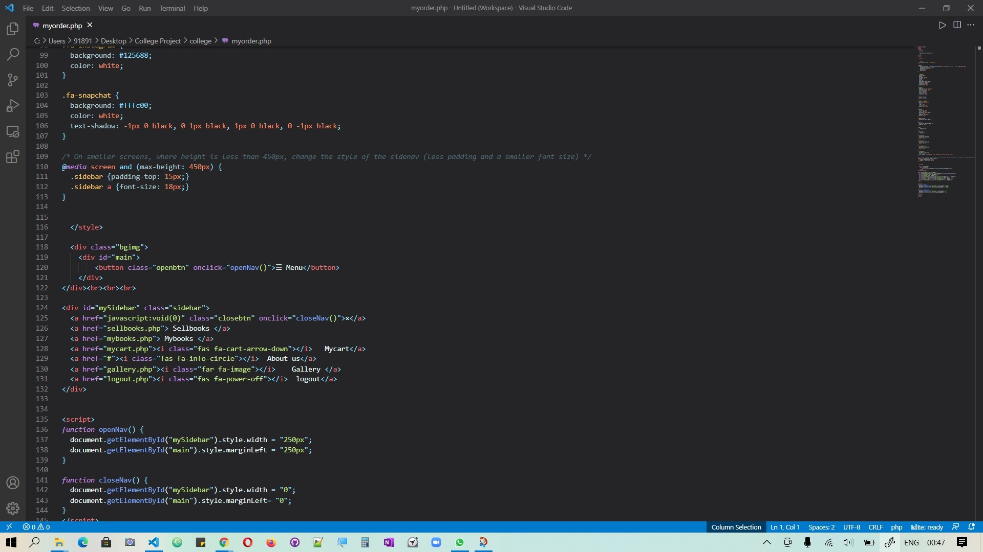

Slide 33
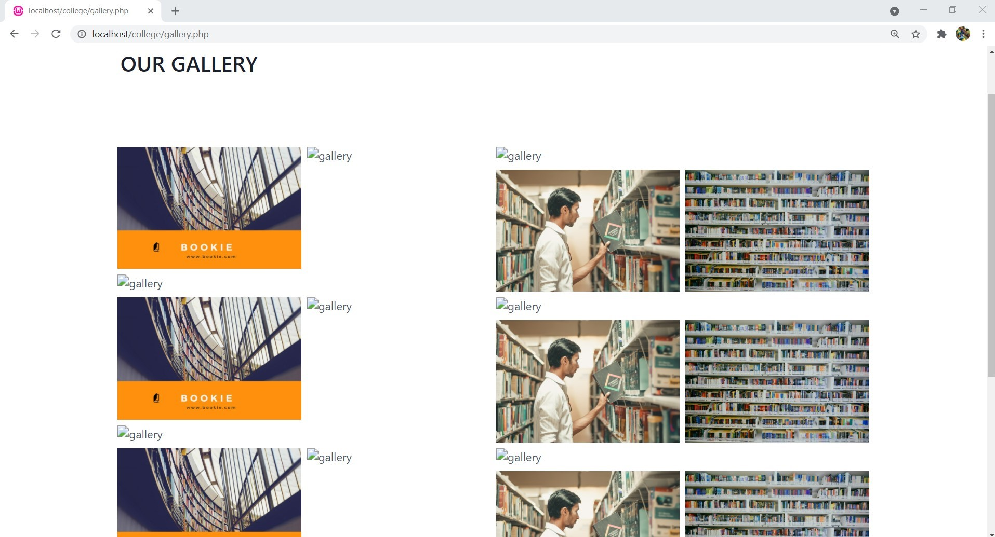

Slide 34
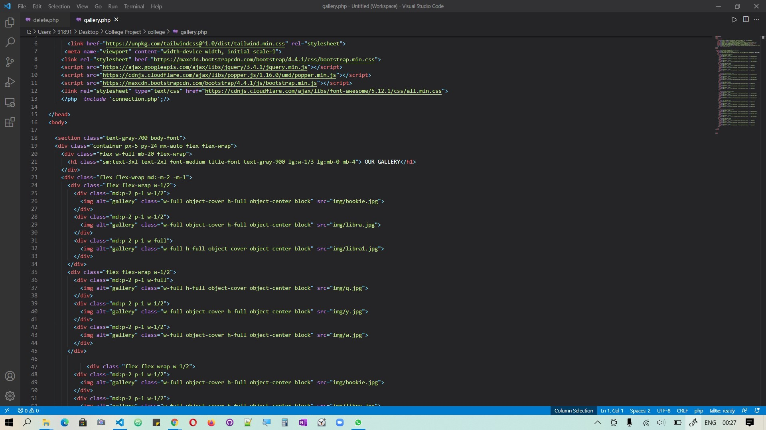

Slide 35
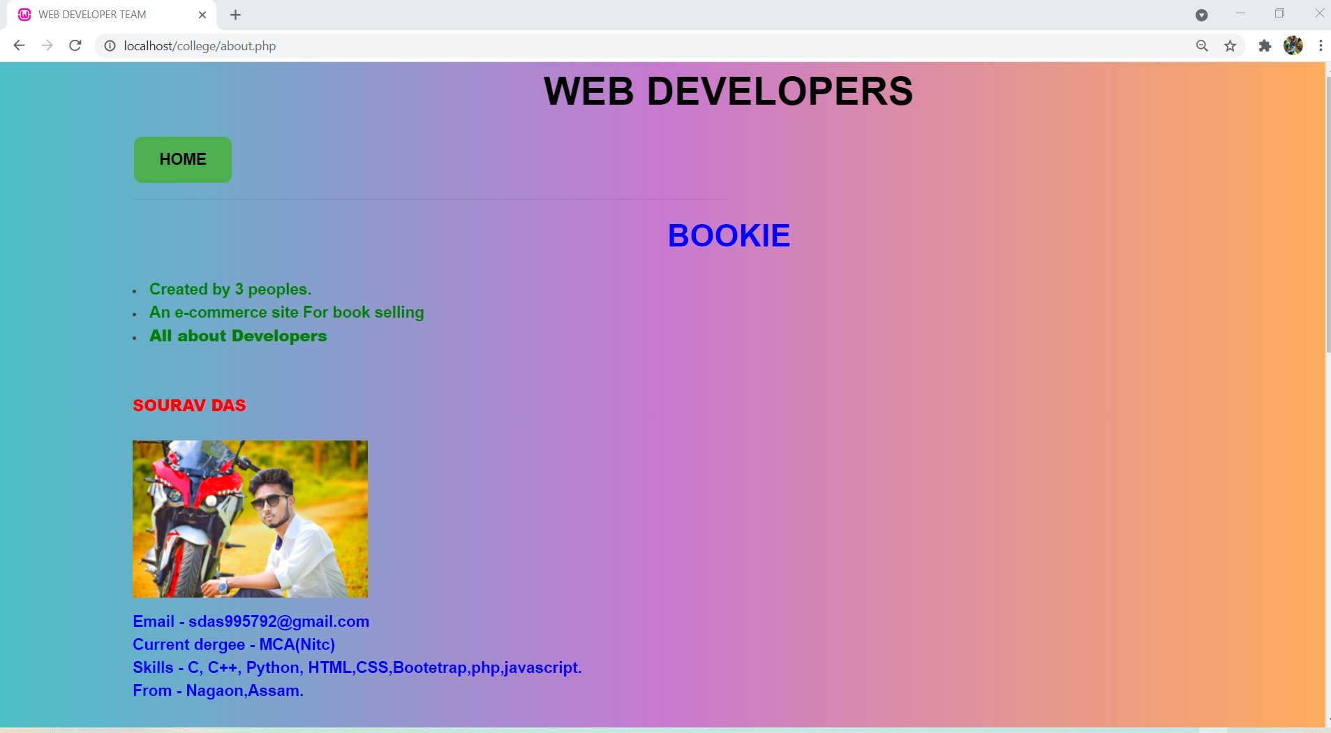

Slide 36
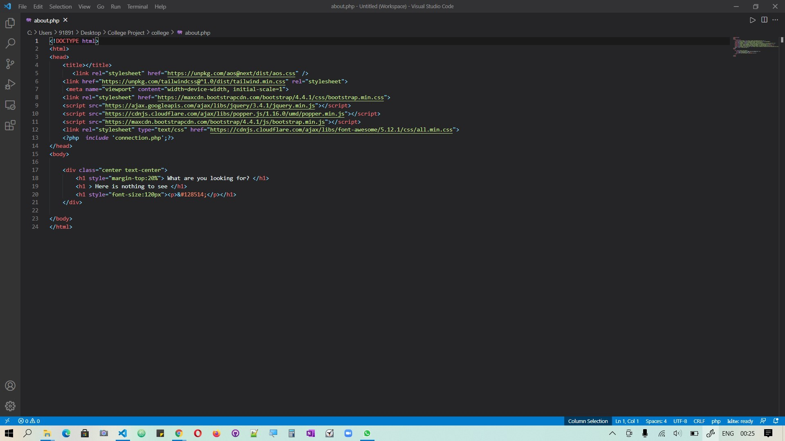

Slide 37

BACKEND DATA
Backend database is accessed by the user indirectly to the database.
Low level manipulation of data through MYSQL commands .
Easy to understand and managed.
This site is used with phpMyAdmin .
An administrator’s tool used for sorting data.
PHP script meant for giving users the ability to interact with their MySQL databases.
The phpMyAdmin program is handy for performing maintenance operation on tables backing up information and editing things directly in the event that this site is not working.

Slide 38

BACKEND Data base

Slide 39
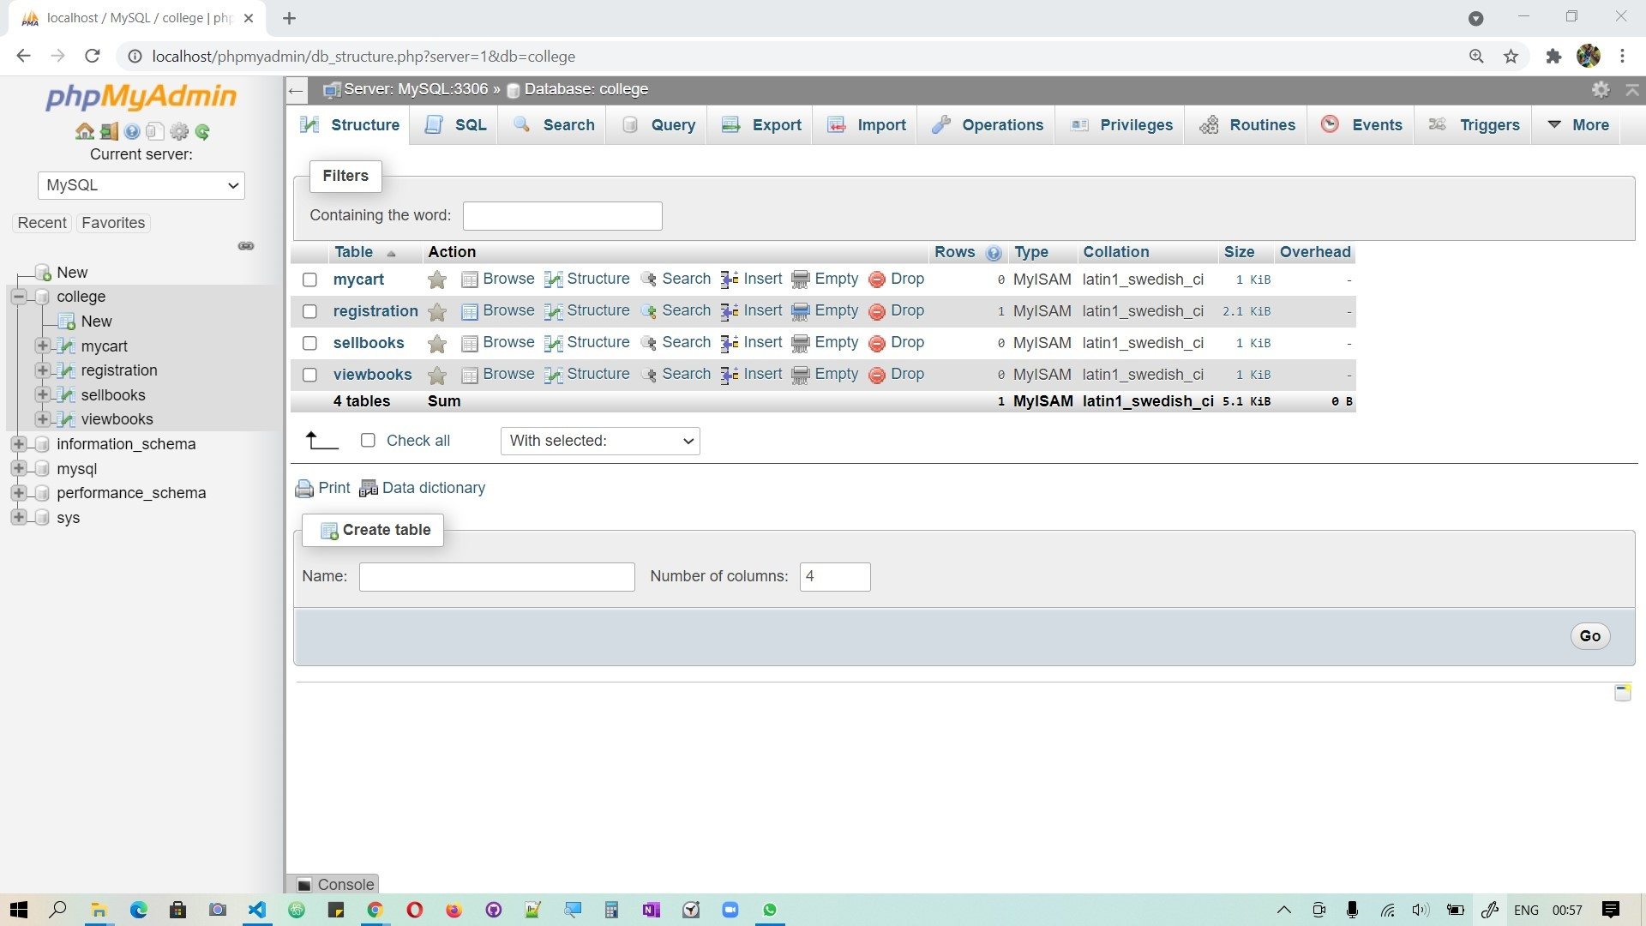

Slide 40
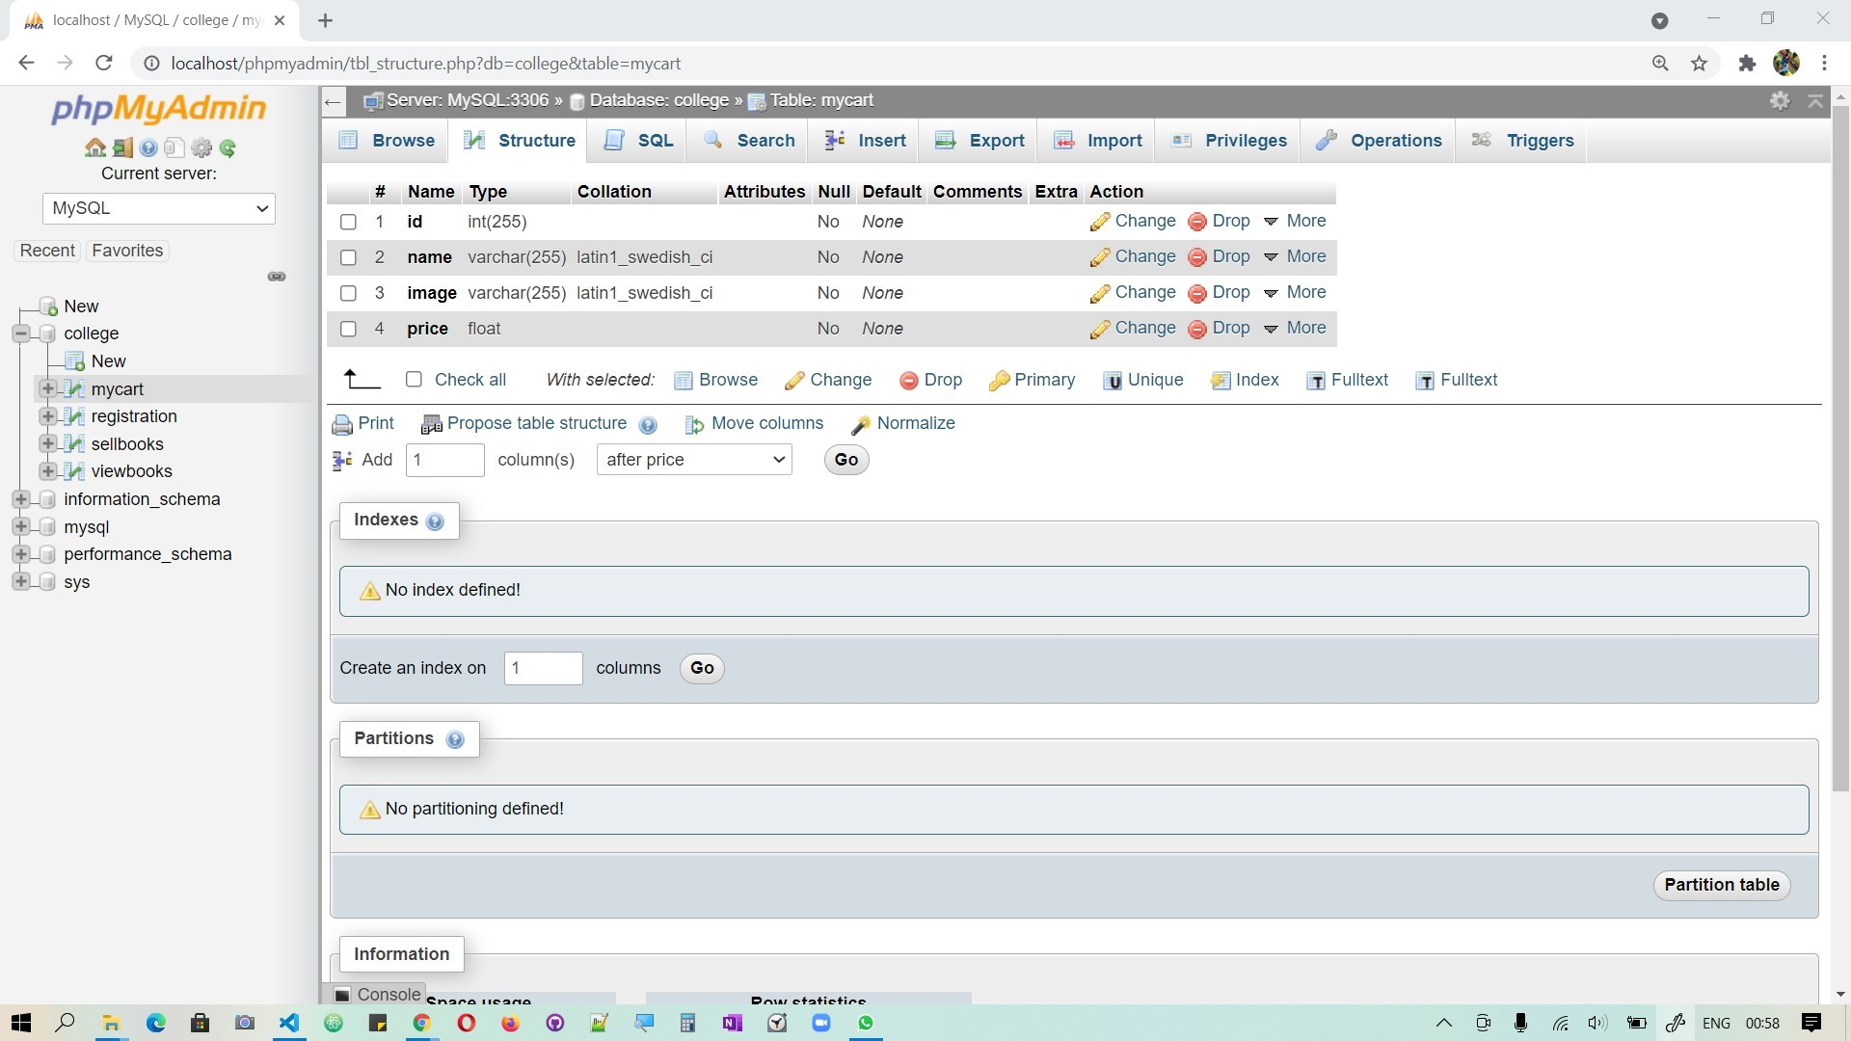

Slide 41
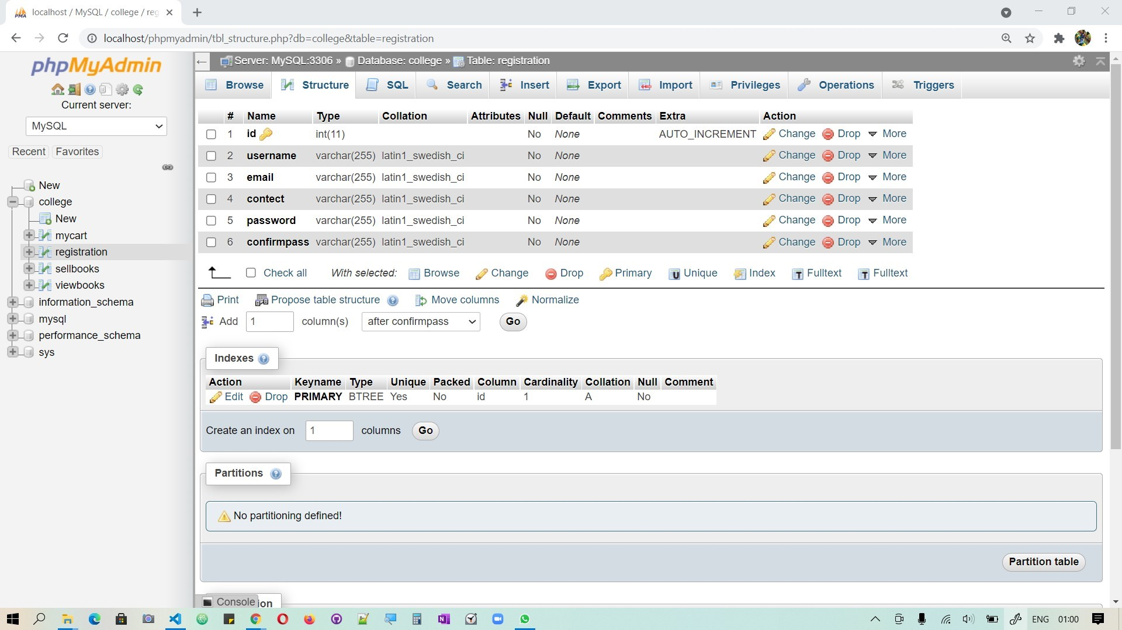

Slide 42
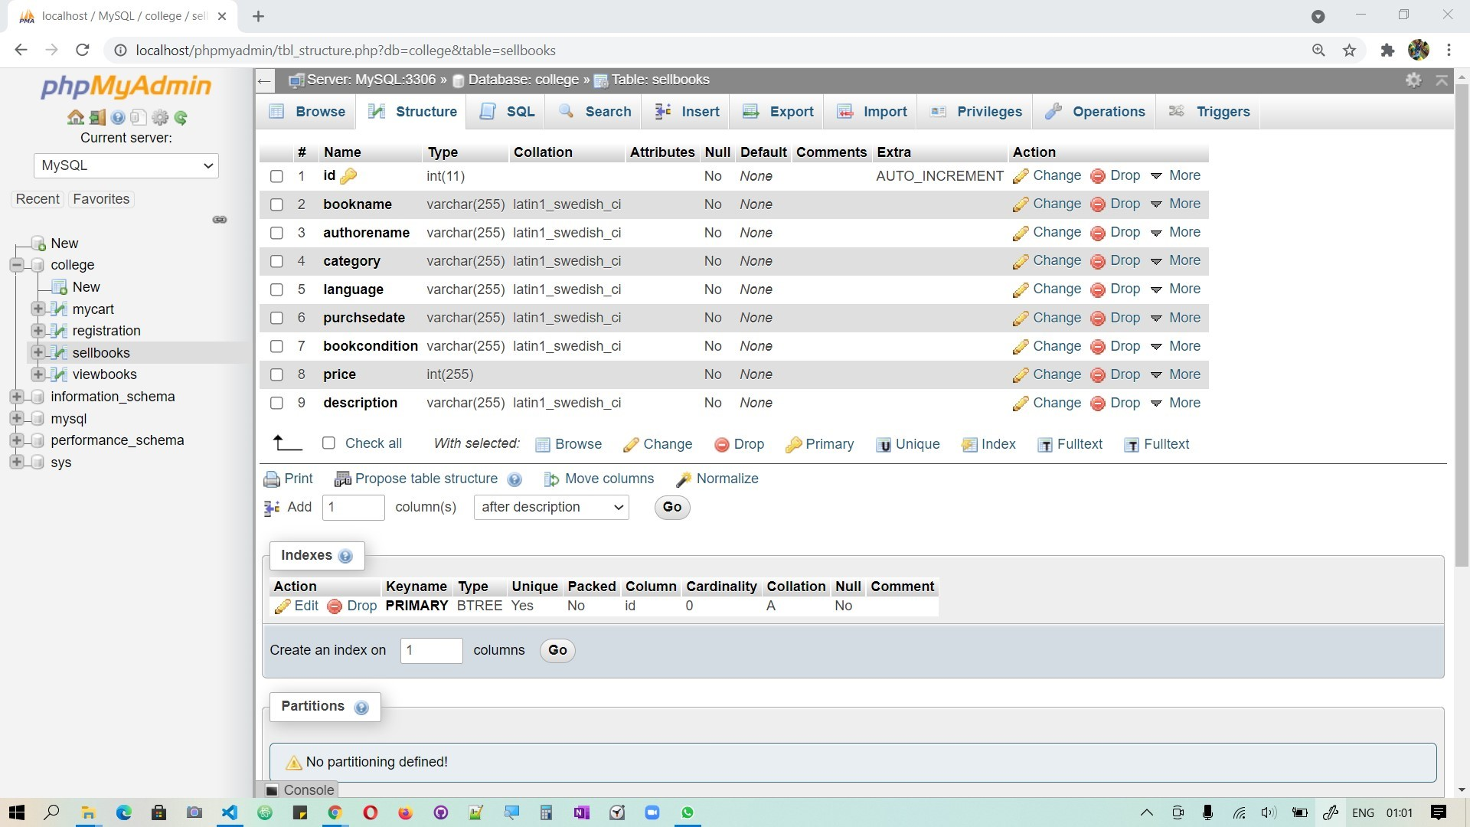

Slide 43
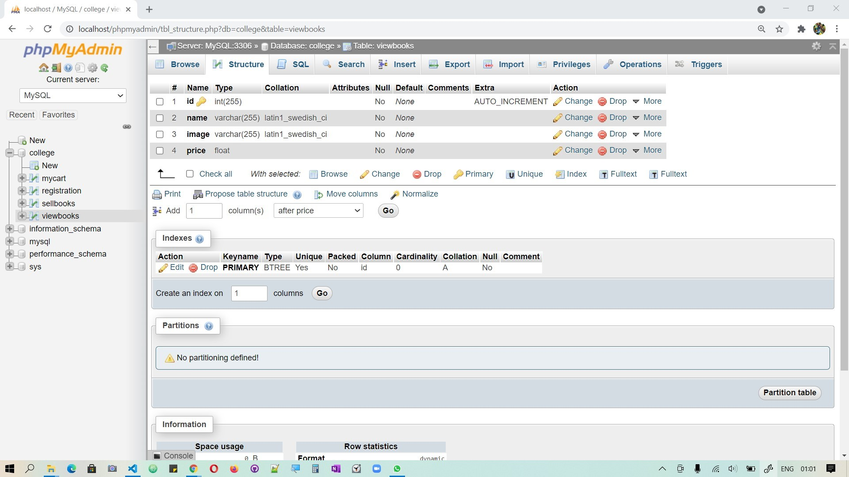

Slide 44

THANK YOU
VERY
MUCH

